Slide 1
Service Fabric
Global Azure Bootcamp STHML 2017
TechX 2017-04-22

Slide 2
Fredrik Göransson
Head of Cloud Architecture Forefront Consulting Group AB
"Fredrik Göransson has worked as an architect in Microsoft environments for the last 15 years and is passionate about .NET, the Microsoft platform and building cutting-edge solutions.”
fredrik.goransson@ffcg.se
http://github.com/FFCG
http://github.com/FredrikGoransson
http://stackoverflow.com/users/1062217/yoape

Slide 3
Service Fabric - Unleashed
Why should you use Service Fabric?
Working with Service Fabric for real?
Deep-dive (if we have time?)
Beyond Getting Started samples?
Nivå: 300 +

Slide 4
Audience
Architects
Developers
Full-Stack DevOps
* Expected some experience in Azure, c#, service oriented development, infrastructure, Getting Started samples for Service Fabric, ironi, persistance, scalable systems, partitioning/sharding, backup/restore models, multi-threaded development, transactions management, .NET core, katana, kestrel, OWIN, WebApi, X509 Certificates, m.m.

Slide 5
Content
Microservices and Distribuerad Arkitektur
Reliable services
Stateful
Stateless
Reliable Actors model
Developing Service Fabric applications
Communication
State, storage & persistance
Running Service Fabric applications
Logging
Monitorering
Building a Service Fabric cluster
Infrastructure
Deployment
Security

Slide 6
01. Microservices och Distribuerad Arkitektur
02. Reliable services
03. Developing Service Fabric applications
04. Running Service Fabric applications
05 Building a Service Fabric cluster
06. Next step...

Slide 7
Why Service Fabric?
Why not use App Service/Web Jobs/Azure Functions/Logic apps/...?
Scaling
Orchestration
Monitoring
Customer
API
Customer
Order Service
Order Processor
Stock Service
B2B Stock
API
App Service
App Service
Web Job
Azure Function
Logic App
App Service

Slide 8
Microservices architecture
Limit responsibilities/abilities
Small size/footprint
Lightweight message-based communication
Bounded context
Autonomous, independent, decentralized…
Modular structure
Services can be built and deployed independently of each other (or with minimal impact)

Slide 9
The monolith
Microservices
Monoliths (usually) span across a complete domain and it’s specific functionality. Possibly separated in functional layers
Scales by creating multiple instances of the entire monolith (or scaling the entire thing UP)
App 1
App 1
App 2
Microservices are separated in smaller functional services working independently
Scales by allowing each service to create independent instances

Slide 10
Distributed architecture
Scalable services
Autonomous responsabilities
Message driven communication
Partitioned persistance
A-D
E-I
J-M
N-R
S-V
W-Z

Slide 11
01. Microservices och Distribuerad Arkitektur
02. Reliable services
03. Developing Service Fabric applications
04. Running Service Fabric applications
05 Building a Service Fabric cluster
06. Next step...

Slide 12


Reliable Services i Service Fabric
Guest Executables
Reliable Services
Stateful Services
Stateless Services
Reliables Actors
A-D
E-I
J-M
N-R
S-V
W-Z
A-D
E-I
J-M
N-R
S-V
W-Z

Slide 13
Stateless services
No state (data)...
Executes in parallell across all INSTANCES
Examples
Web/API
CPU-bound processer
External state/persistens

Slide 14
Stateless services - instanser
Instance Count = -1
(total instances = 6)
Instance
http://mycluster.com:56421 (http://10.0.0.5:56421)
http://mycluster.com:56421 (http://10.0.0.4:56421)
I₅
48fb23ae-836e-4a6b-8ae8-47f6e75dd489
Port: 56421
I₄
41758dfc-5ed6-48ed-bb62-a1982211de2f
I₃
3d17e8ac-6ef0-4a60-a127-44e451aa6b28
I₂
23e35218-8fc2-47aa-b974-37ecb043b3ea
I₁
0f4629fe-2d7f-4dc9-8f33-1c3b6df5edda
N₀
N₁
N₂
N₃
N₄
10.0.0.1
10.0.0.2
10.0.0.3
10.0.0.4
10.0.0.5

Slide 15
Stateful services
State stored inside the service
Partitioned across a determined number of partitions
State is replicated to a defined span of replicas
State is stored as Reliable Collection or Reliable Queue
Executes in parallell across all PARTITIONS
Examples
Lookup-/index-service
Long-running processes
Processing queues
...

Slide 16
Stateful services – partitions and replicas
http://mycluster.com:53122/41758dfc-5ed6-48ed-bb62-a1982211de2f/131292412751868819
Partition Count = 6
Replica Count = 3
(total instances 3x6 = 18)
Partition
Replicas
S₁
S₁
P₆
728a56fd-1715-4b65-9b7d-e90e5a5838a7
131299935028265326
131299935028265327
131299935028265328
S₂
P₅
S₁
48fb23ae-836e-4a6b-8ae8-47f6e75dd489
131299935028423334
131299935028423335
131299935028423336
Port: 53122
S₂
S₁
P₄
P₂
41758dfc-5ed6-48ed-bb62-a1982211de2f
131299935028423334
131299935028423335
131299935028423336
8033FAA5-E521-4D71-8E49-4370B82E2C2F
P₃
S₁
S₂
3d17e8ac-6ef0-4a60-a127-44e451aa6b28
131299935028265326
131299935028265327
131299935028265328
S₁
P₂
S₂
23e35218-8fc2-47aa-b974-37ecb043b3ea
131299935028423334
131299935028423335
131299935028423336
P₁
S₁
S₂
0f4629fe-2d7f-4dc9-8f33-1c3b6df5edda
131299935028423334
131299935028423335
131299935028423336
http://mycluster.com:53122/23e35218-8fc2-47aa-b974-37ecb043b3ea/131292412105854469
http://mycluster.com:53122/23e35218-8fc2-47aa-b974-37ecb043b3ea/131292412303458761
N₀
N₁
N₂
N₃
N₄
10.0.0.1
10.0.0.2
10.0.0.3
10.0.0.4
10.0.0.5

Slide 17
Designing for Microservices
Defined responsabilities for each service
Domain Driven Design, DDD
Interfaces and messages
Scaling
Partitioning
Performance

Slide 18
01. Microservices och Distribuerad Arkitektur
02. Reliable services
03. Developing Service Fabric applications
04. Running Service Fabric applications
05 Building a Service Fabric cluster
06. Next step...

Slide 19
Example App ”Who is presenting at TechX 2017?”
http://
Web API
fabric:/
Scraper

Slide 20
DEMO – Stateless services
https://github.com/FredrikGoransson/TechX.SF.Demo

Slide 21
Example App ”Who is presenting at TechX 2017?”
A-D
http://
E-I
fabric:/
J-M
Web API
fabric:/
N-R
S-V
W-Z
SpeakerActors
Scraper

Slide 22
DEMO – Actors
https://github.com/FredrikGoransson/TechX.SF.Demo

Slide 23
Communication and interfaces
Fabric Transport (a.k.a. Service Remoting)
RPC-style communication between services in a cluster
Works between applications, not in or out of the cluster
Built-in adress resolution, fault handling, logging (ETW)
HTTP(S)
Works in or out of the cluster
Ports-based – eller –
Reverse Proxy
WCF
Queues

Slide 24
DEMO – Actor commuication
https://github.com/FredrikGoransson/TechX.SF.Demo

Slide 25
Actor services och state
Actor calls are single-threaded
ActorService handles multiple parallel Actors
ActorService manages ActorStateProvider that is responsible for persisting state for each Actor in the ActorService
Actor
ActorService
StateManager
StateProvider

Slide 26
Utveckling
General on Reliable Services/Actors
Services and Actors relationships
Calling Services/Actors
Audit information
Services and Actor microsservices
DDD and AggregateRoots
Scaling and performance considerations
State storage
Backup/restore
Search
External storage – DocumentDB
Exception/Error handling
Handling
Retrying
Testing/mocking
Dependency injection
Mock objects
Integration tests with MockFabricRuntime
Standalone OWIN web

Slide 27
01. Microservices och Distribuerad Arkitektur
02. Reliable services
03. Developing Service Fabric applications
04. Running Service Fabric applications
05 Building a Service Fabric cluster
06. Next step...

Slide 28
Loggning i Service Fabric
Event Tracing for Windows (ETW)
EventSource
Lightweight
Low-level
Well established
OMS/Log Analytics for monitoring
EventFlow for streaming ETW events to (for instance) Application Insights
https://github.com/Azure/diagnostics-eventflow
Use Semantisk Loggning!
https://msdn.microsoft.com/en-us/library/dn440729.aspx

Slide 29
DEMO – Service Fabric logging
https://github.com/FredrikGoransson/TechX.SF.Demo

Slide 30
01. Microservices och Distribuerad Arkitektur
02. Reliable services
03. Developing Service Fabric applications
04. Running Service Fabric applications
05 Building a Service Fabric cluster
06. Next step...

Slide 31
Infrastrukturen i Service Fabric
Azure Portal Marketplace – ”Service Fabric cluster”
ARM template
Cluster
Storage Accounts
Load Balancers
Virtual Machine Scale Sets
Security
Certifikat based
KeyVault

Slide 32
Service Fabric cluster ARM template
Load Balancer
Port rules
Probes
VMSS
ETWProviders – Diagnostics
Admin Certificates
Thumbprints for VM nodes

Slide 33
DEMO – Service Fabric ARM template
https://github.com/FredrikGoransson/TechX.SF.Demo

Slide 34
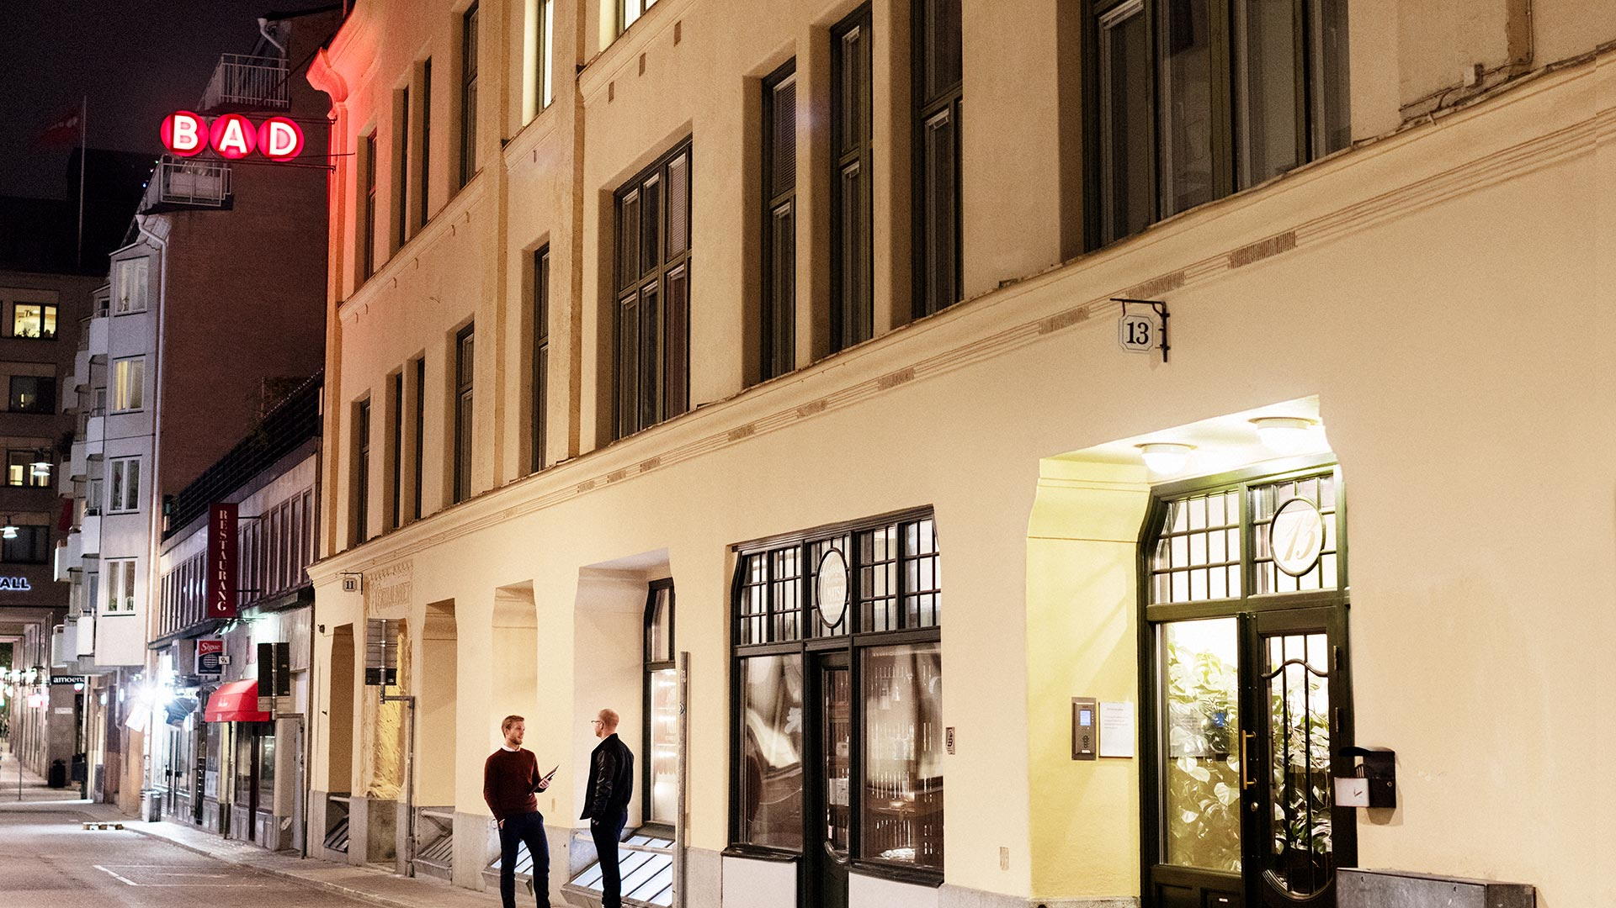
www.ffcg.se

